Slide 1
Banking dataset analysis using python Finlatics dsep

Slide 2
agenda
Introduction
Data Definition
Process
Insights
Final tips & takeaways

Slide 3
Introduction
Term deposits are a key revenue stream for banks, involving investing funds for a fixed period to earn interest.
Banks use various outreach strategies like email, ads, phone calls, and digital marketing to promote term deposits.
Despite digital options, phone marketing remains effective but requires significant investment in call centers.
Identifying potential customers likely to subscribe is crucial for targeted phone outreach.
Data pertains to a Portuguese bank's direct marketing campaigns aiming to predict term deposit subscription.

Slide 4
Analytics
What the data represents?

Slide 5
Data Definition
The dataset contains information on direct marketing campaigns of a Portuguese banking institution.
Marketing involved phone calls, often requiring multiple contacts to determine if clients subscribed to a term deposit.
There are 18 columns in the dataset, including:
Age, job, marital status, education, default status, average yearly balance, housing loan status, personal loan status, type of contact, last contact day and month, duration of last contact, number of contacts performed in the campaign, days since last contact from previous campaign, number of previous contacts, outcome of previous campaign, and the target variable indicating subscription to a term deposit.
The target variable 'y' indicates whether the client subscribed to a term deposit.
Data spans from May 2008 to November 2010 with 45,211 rows.

Slide 6

process
Data Collection
Data Cleaning
Data Processing
Data Analysis
Results

Slide 7
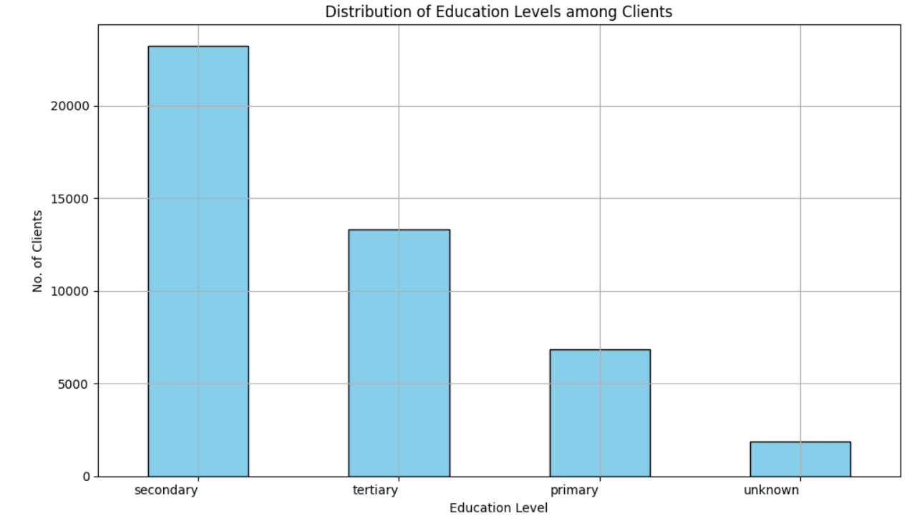
insights

Slide 8
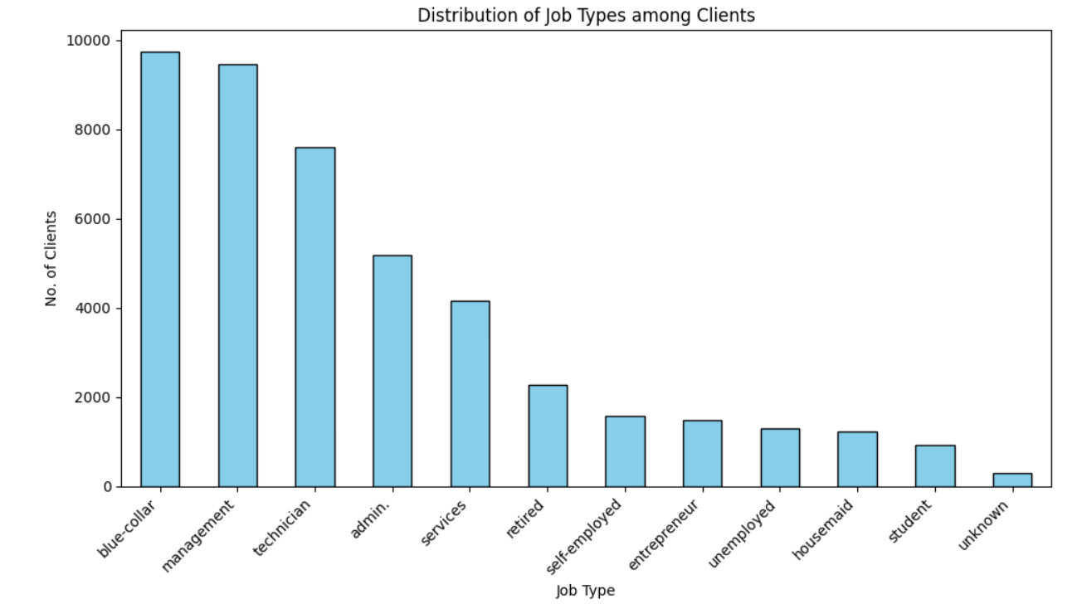

Slide 9
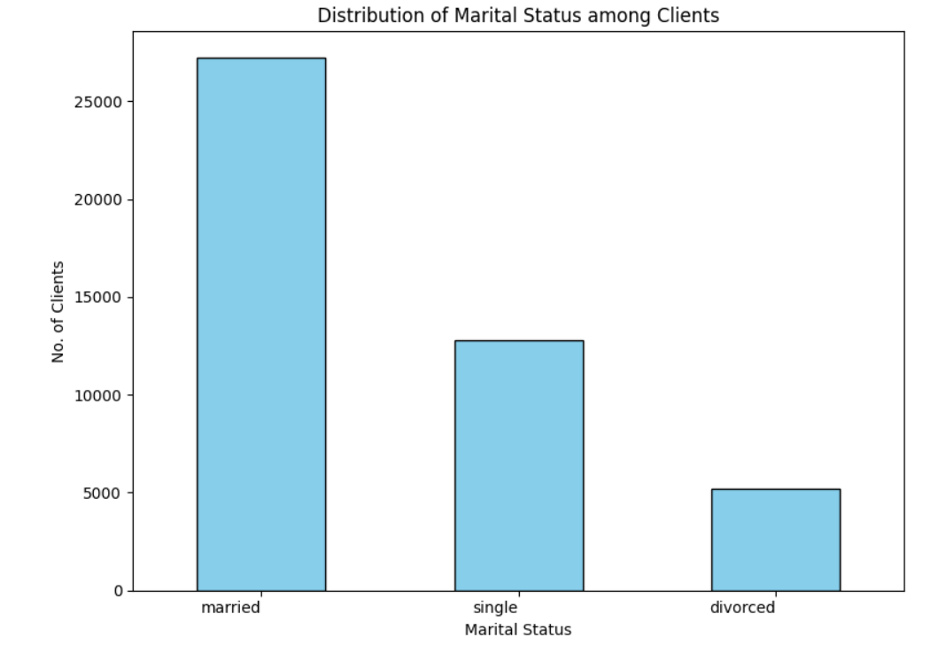

Slide 10
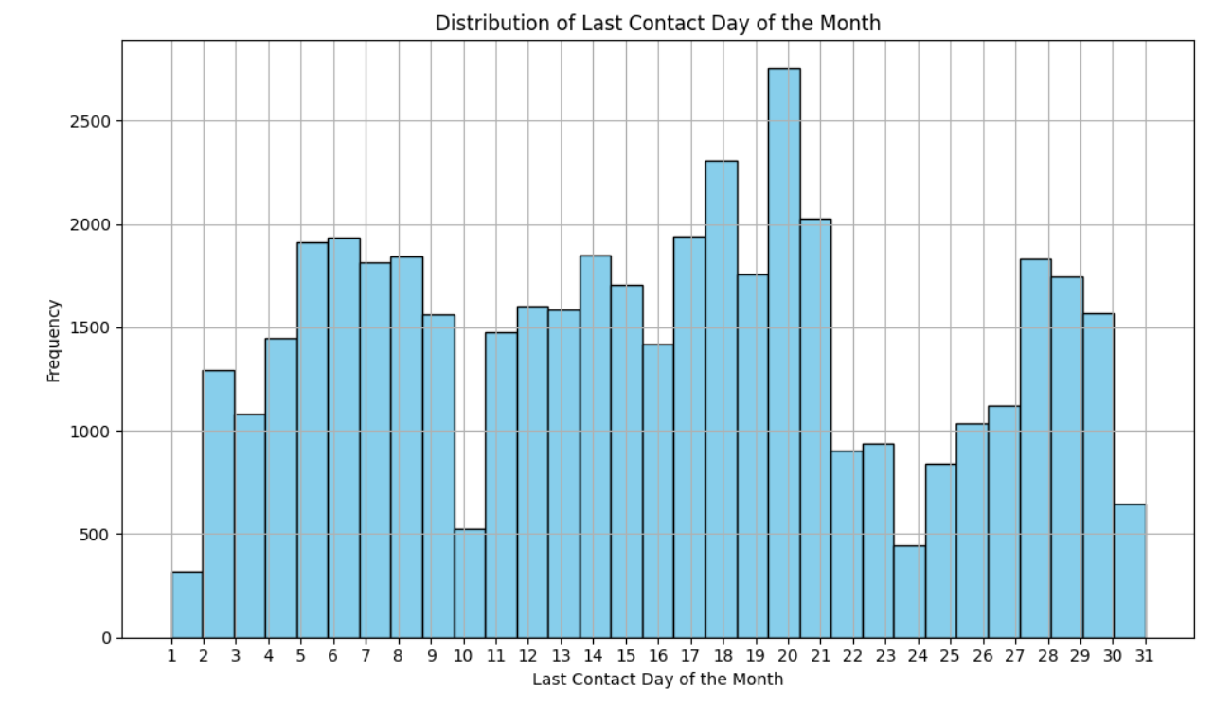

Slide 11
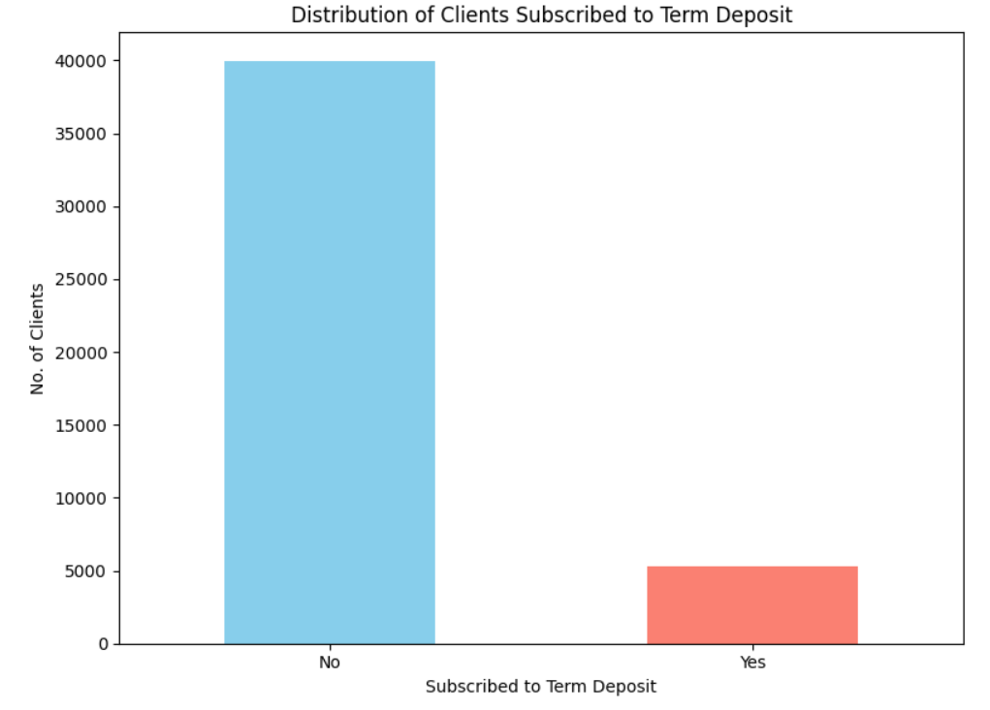

Slide 12
Final tips & takeaways
Categorical Variables:
Job type, marital status, education level, and outcome of the previous marketing campaign (poutcome) are associated with subscription likelihood.
Numerical Variables:
Balance, duration of last contact, and days passed since the last contact (pdays) could influence subscription.
Age shows weak correlation, while the number of contacts in current and previous campaigns might be relevant.

Slide 13
Thank you

